Slide 1
Solid state
Part – 1 chemistry
I B.Sc, semester – 1, paper – 1
Vijaya Lakshmi sada Guest faculty
P.R. Govt. college (A), kakinada
1

Slide 2
Contents:
Bragg’s Law
Powder method
2

Slide 3
Solid state
Bragg’s Law
The structures of crystals and molecules are often being identified using x-ray diffraction studies, which are explained by Bragg’s Law. The law explains the relationship between an x-ray light shooting into and its reflection off from crystal surface.
3

Slide 4
Introduction
Bragg’s law was introduced by Sir W.H. Bragg and his son Sir W.L. Bragg. The law states that when the x-ray is incident onto a crystal surface, its angle of incidence, θ, will reflect back with a same angle of scattering, θ. And, when the path difference, d is equal to a whole number, n, of wavelength, a constructive interference will occur.
Consider a single crystal with aligned planes of lattice points separated by a distance d. Monochromatic X-rays A, B, and C are incident upon the crystal at an angle θ. They reflect off atoms X, Y, or Z.
4

Slide 5
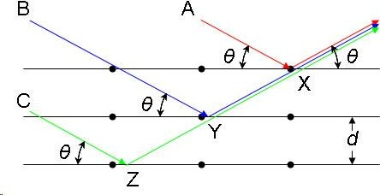
5

Slide 6
The path difference between the ray reflected at atom X and the ray reflected at atom Y can be seen to be 2YX. From the Law of Sines we can express this distance YX in terms of the lattice distance and the X-ray incident angle:
If the path difference is equal to an integer multiple of the wavelength, then X-rays A and B (and by extension C) will arrive at atom X in the same phase. In other words, given the following conditions:
then the scattered radiation will undergo constructive interference and thus the crystal will appear to have reflected the X-radiation. If, however, this condition is not satisfied, then destructive interference will occur.
6

Slide 7
Bragg’s Law
nλ=2dsinθ
where:
λ is the wavelength of the x-ray,
d is the spacing of the crystal layers (path difference),
θ is the incident angle (the angle between incident ray and the scatter plane), and
n3 is an integer
The principle of Bragg’s law is applied in the construction of instruments such as Bragg spectrometer, which is often used to study the structure of crystals and molecules.
7

Slide 8
Powder Method:
In this method a finely powdered specimen is placed in a monochromatic beam, often Ka radiation of X-rays. Just by chance, some of its microcrystals will be oriented at correct diffraction angle for a particular set of planes and a diffraction beam will result. The incident monochromatic radiation strikes the finely powdered specimen or fine grained polycrystalline specimen contained in a capillary tube. A photographic film is wrapped around the inside of a cylindrical chamber concentric with the sample. The rays are diffracted from individual microcrystals which happen to be oriented with planes making Bragg angle θ with the beam; the various diffracted rays lying, of course, along the generators of cones are concentric with the incident beam.
To understand the point clearly, consider the same set of planes (hkl) in each microcrystal of the powder. Since the microcrystals are oriented in all possible

Slide 9
directions, these planes have all possible orientations and the rays diffracted by this set of planes (hkl) in the powder pass through various points forming, clearly, cone that is concentric about the incident X-ray beam.
The half-opening angle of the cone is 2θ, where θ is the Bragg angle. Different (hkl) planes produce different similar cones. Now, since the film is wrapped around the inside of a cylindrical chamber concentric with the sample, a certain portion of these diffracted cones will be intercepted and a series of arcs is produced on the film. A typical diffraction pattern is shown in Fig. 2.70 (a).

Slide 10
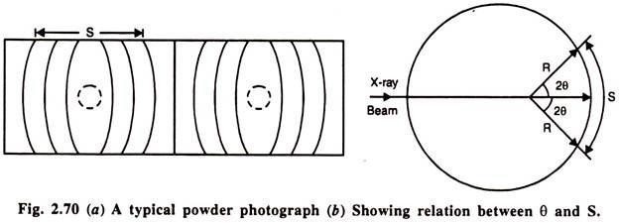
Let us see how the diffraction patterns of this method are used to determine the crystal structure. With reference to the Fig. 2.70 (a) and (b) suppose S is the distance

Slide 11
on the film between the diffraction arcs corresponding to a particular plane and 4θ is the full-opening angle of the corresponding cone, then we have-
S = 4θ R, (θ in radians)
Where, R is the specimen-to-film distance, usually the radius of the camera housing the film. For easy conversion of the distance S measured in mm to Bragg angle in degrees, the camera radius is often chosen to be 57.3 mm as 1 rad = 57.3°. A list of θ values can thus be prepared directly from the measured values of S. Since the wavelength is known, substitution of θ and λ in 2d sin θ = nλ gives a list of spacing of d.

Slide 12
Use of the geometrical relations between the crystallographic axes, the Miller indices, and dhkl can now be made to assign the appropriate indices to each reflection and to determine the unit cell dimensions. We shall illustrate the procedure for the cubic system. For this system the interplanar spacing is-
It is rather much convenient to use the graphical form of this relation; this is shown in Fig. 2.71. Since the possible values, that the indices h, k, I can have are the same for all cubic crystals, this graph can be used to index all the cubic crystals. Now, to use this graph, the ordinates are drawn corresponding to the measured values of d and the intersection of these ordinates with the lines of graph is sought along the same horizontal line as is explained in the figure.

Slide 13
In this, line can be expected to pass through the intersection of the ordinate corresponding to the largest value of d with (100), (110), or (111). Once this match is obtained, intersection of the horizontal line with the vertical axis of the graph marks the value of ‘a’ of the crystal examined. Thus, the unit cell dimensions and the indices of the reflecting plane are determined at the same time. Similar graphical methods have also been developed for indexing powder photographs of crystals belonging to other systems.

Slide 14
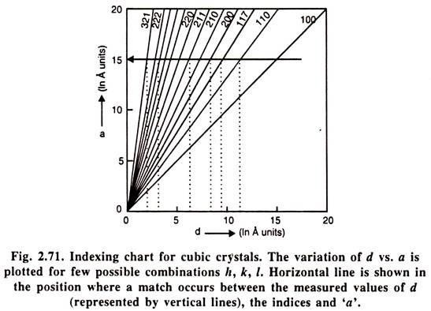

Slide 15
The exposure in a powder camera must be sufficiently long to give reflected lines of good intensity. The exposure time is usually a few hours. After the film is exposed and developed, it is indexed to determine the crystal structure. It is easily seen that the first arc on either side of the exit point corresponds to the smallest angle of reflection. The pair of arcs beyond this pair have larger Bragg angles and are from planes of smallest spacings, recall d = λ/ (2 sin θ).
In the powder method, the intensity of the reflected beam can also be recorded in a diffractometer which uses a counter in place of the film to measure intensities. The counter moves along the periphery of the cylinder and records the reflected intensities against 2θ. Peaks in the diffractometer recording (Fig. 2.72) correspond to positions where the Bragg condition is satisfied by some crystallographic planes.

Slide 16
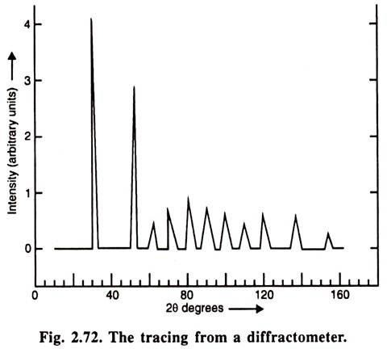

Slide 17
THANK YOU

